Slide 1
Recommendation systems
-By Vamsi Krishna Kodavati

Slide 2
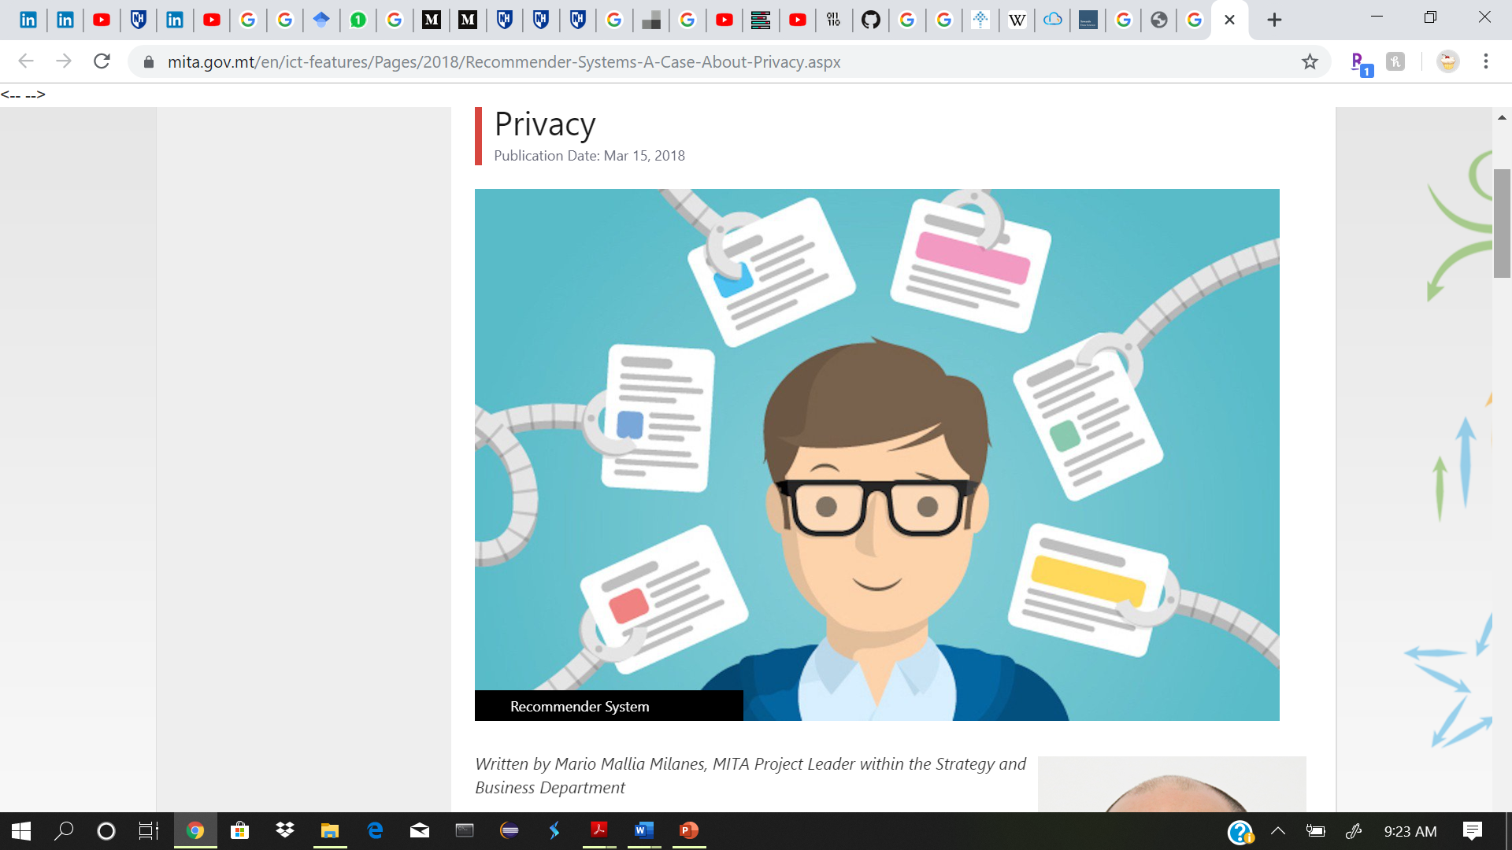
What is a Recommendation system??
It a subclass of information filtering system that seeks to predict the "rating" or "preference" a user would give to an item. They are primarily used in commercial applications.
Recommender systems are utilized in a variety of areas, and are most recognized as playlist generators for video and music services like Netflix, YouTube and Spotify, product recommenders for services such as Amazon, or content recommenders for social media platforms such as Facebook and Twitter

Slide 3
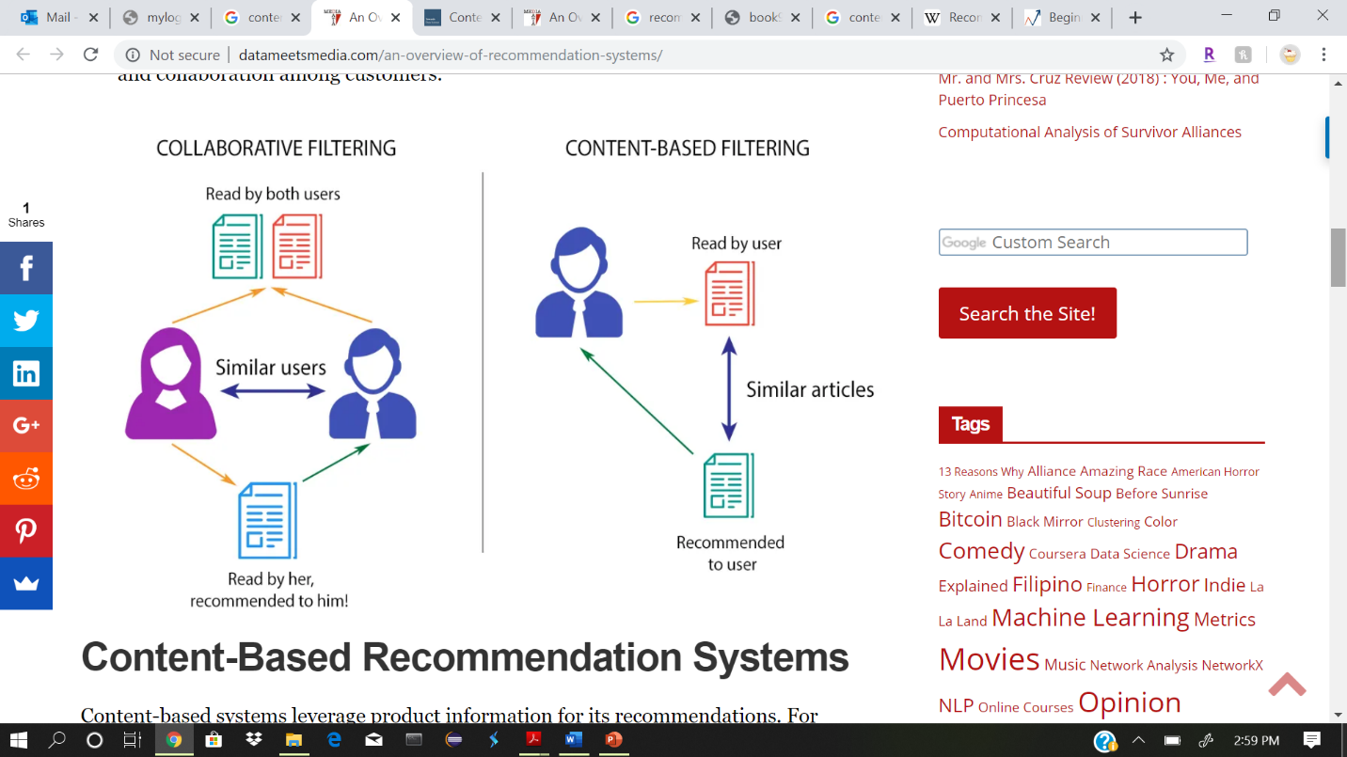
Types of recommendation systems
There are basically three important types of recommendation engines:
1)Collaborative filtering
2)Content-Based Filtering
3) Hybrid Recommendation Systems

Slide 4
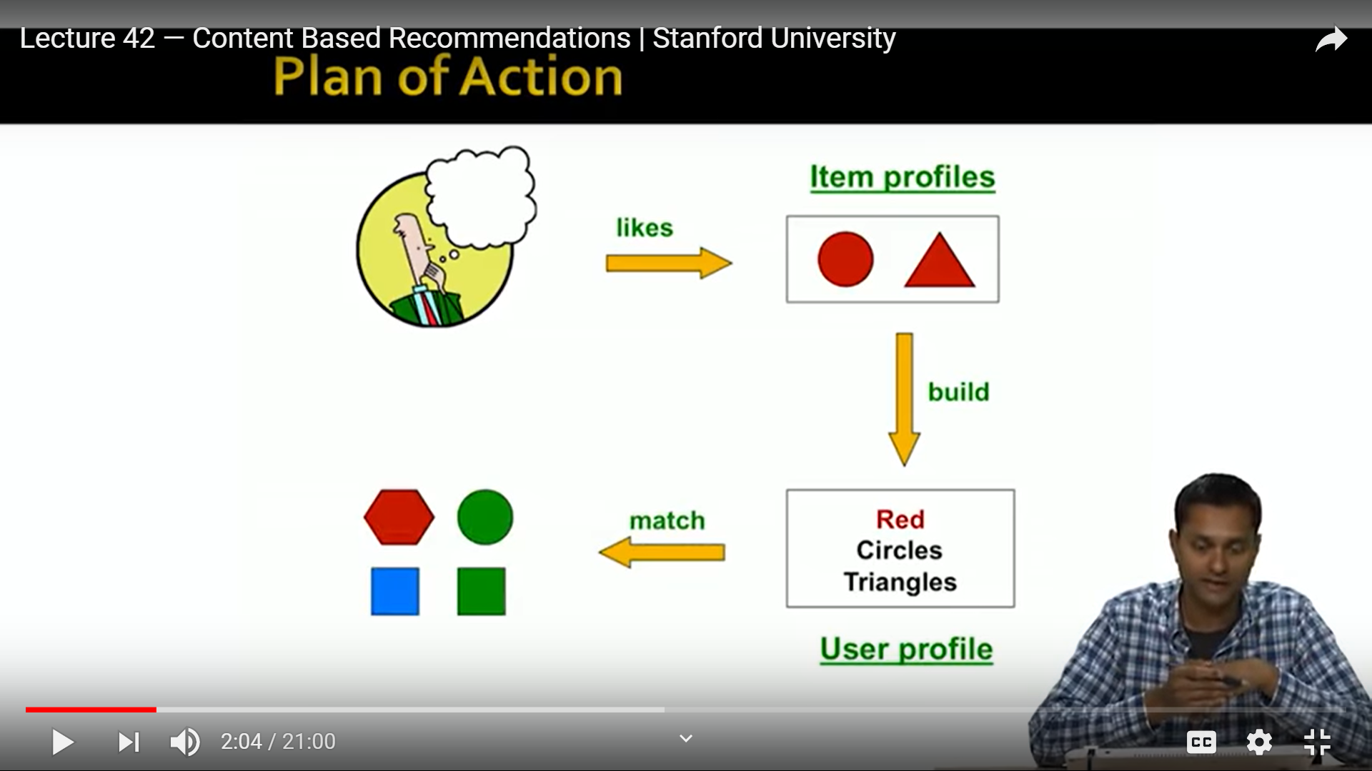
Content Based Recommendation system
Recommend items to customer X similar to previous items rated highly by X
Examples:
Movies: Same actors, directors, genre
Linkend-In: Jobs you were interested in

Slide 5
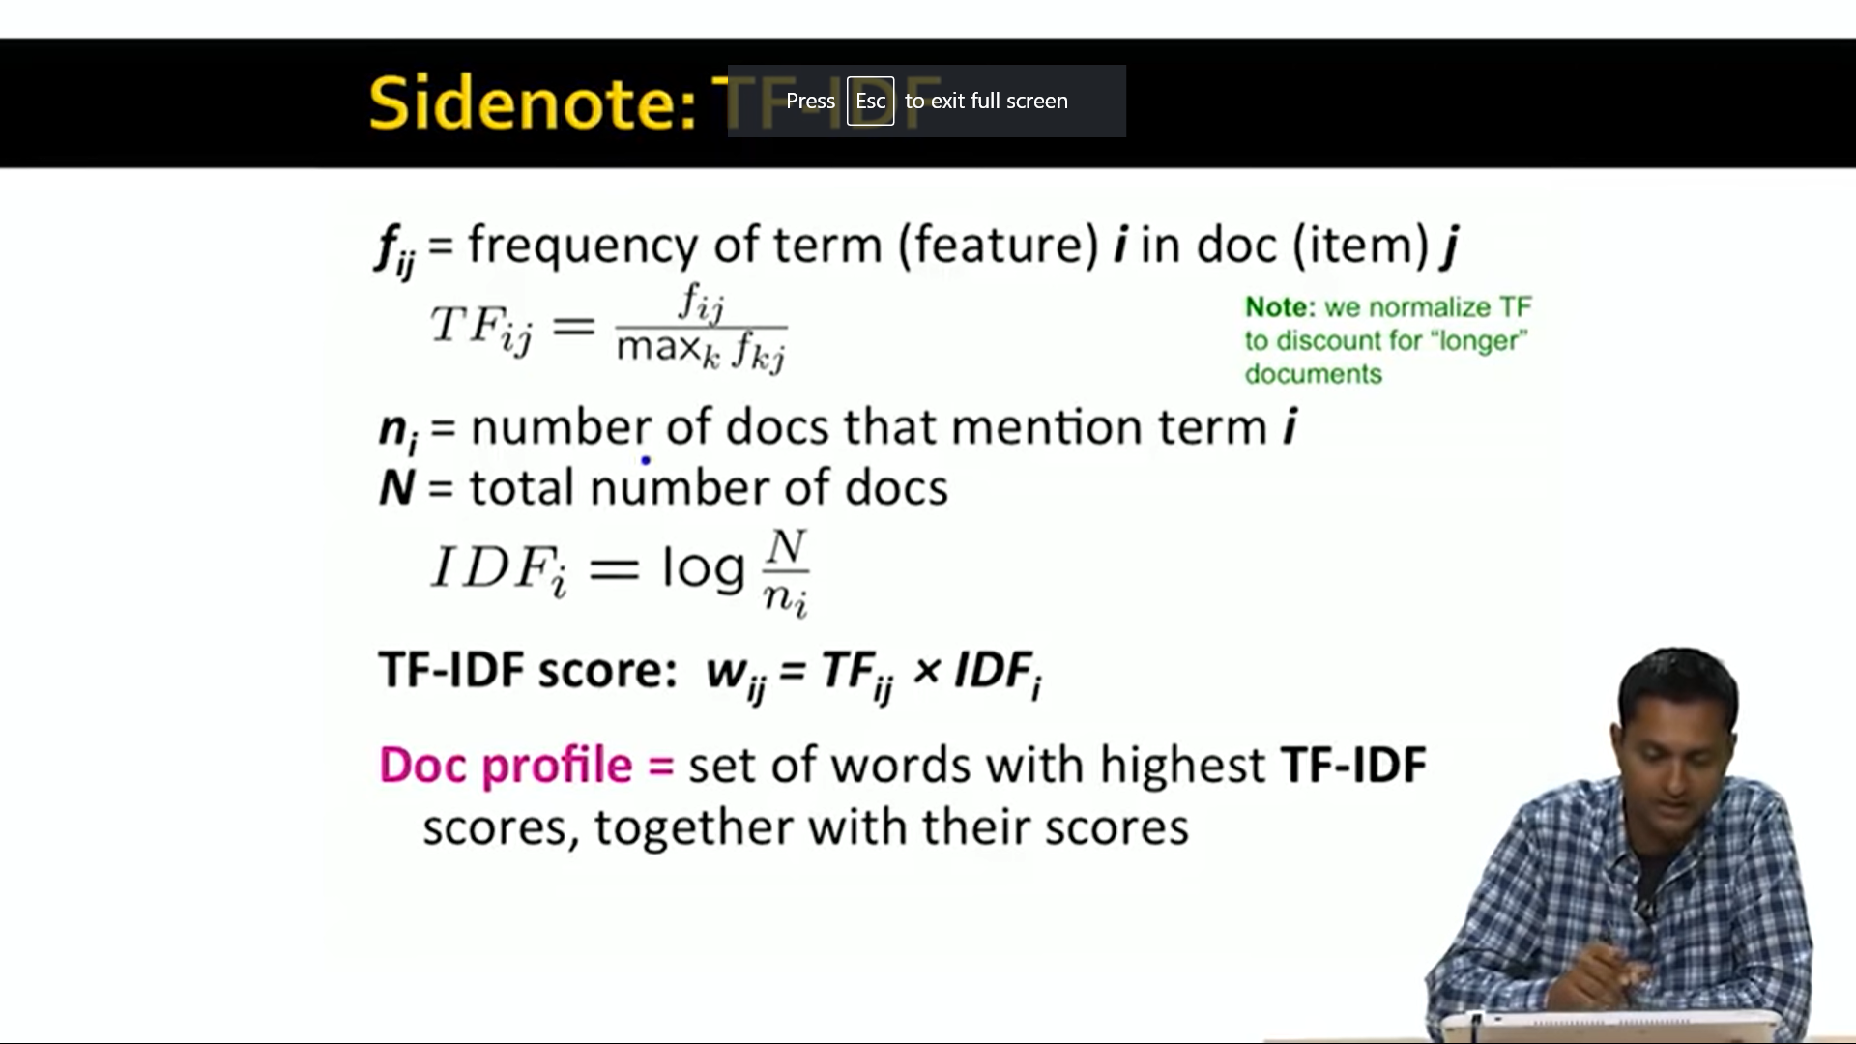
Item Profiles
For each item ,create an item profile
Profile is a set of features
1)movies: author, title, actor, director
2)Images, videos: meta data and tags
Convenient to think the item profile as a vector
1) ine entry per feature(ex each director, actor)
2)Vector might be Boolean or real valued

Slide 6

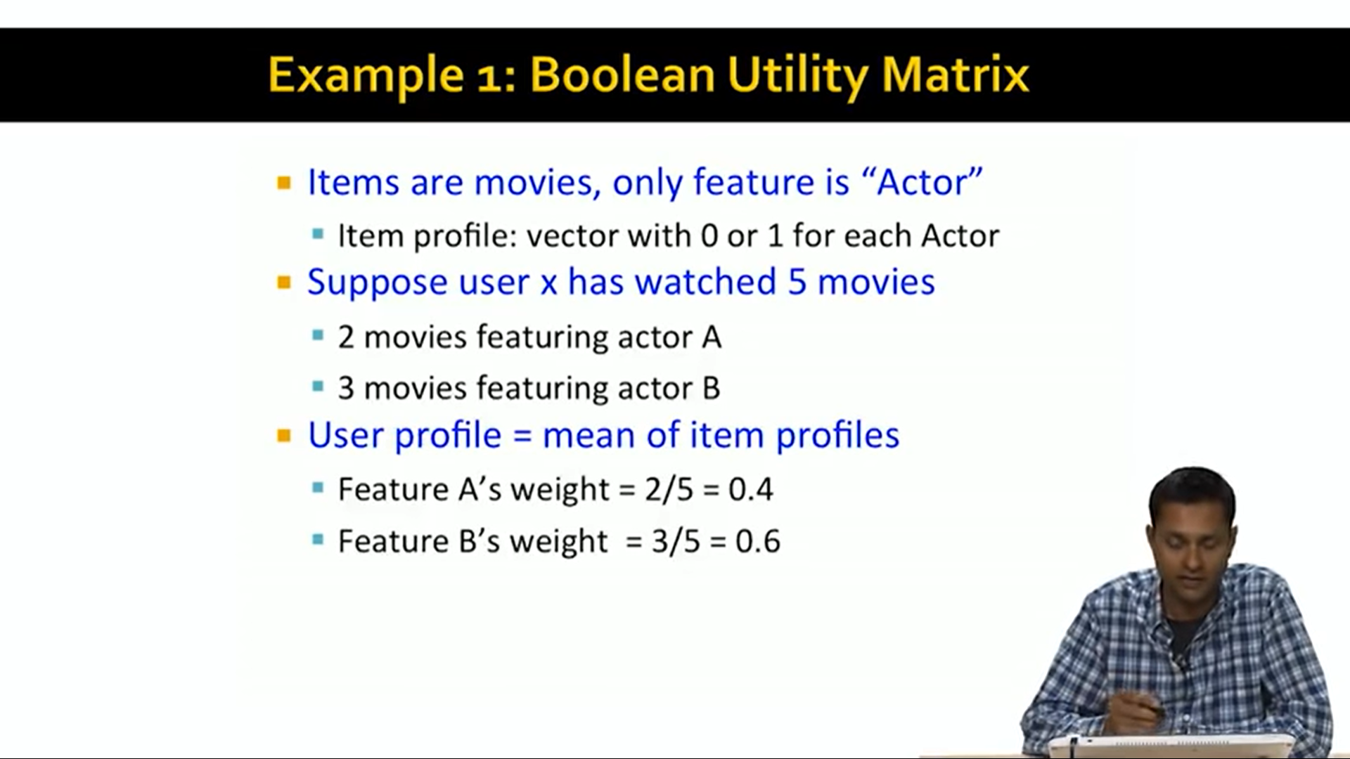
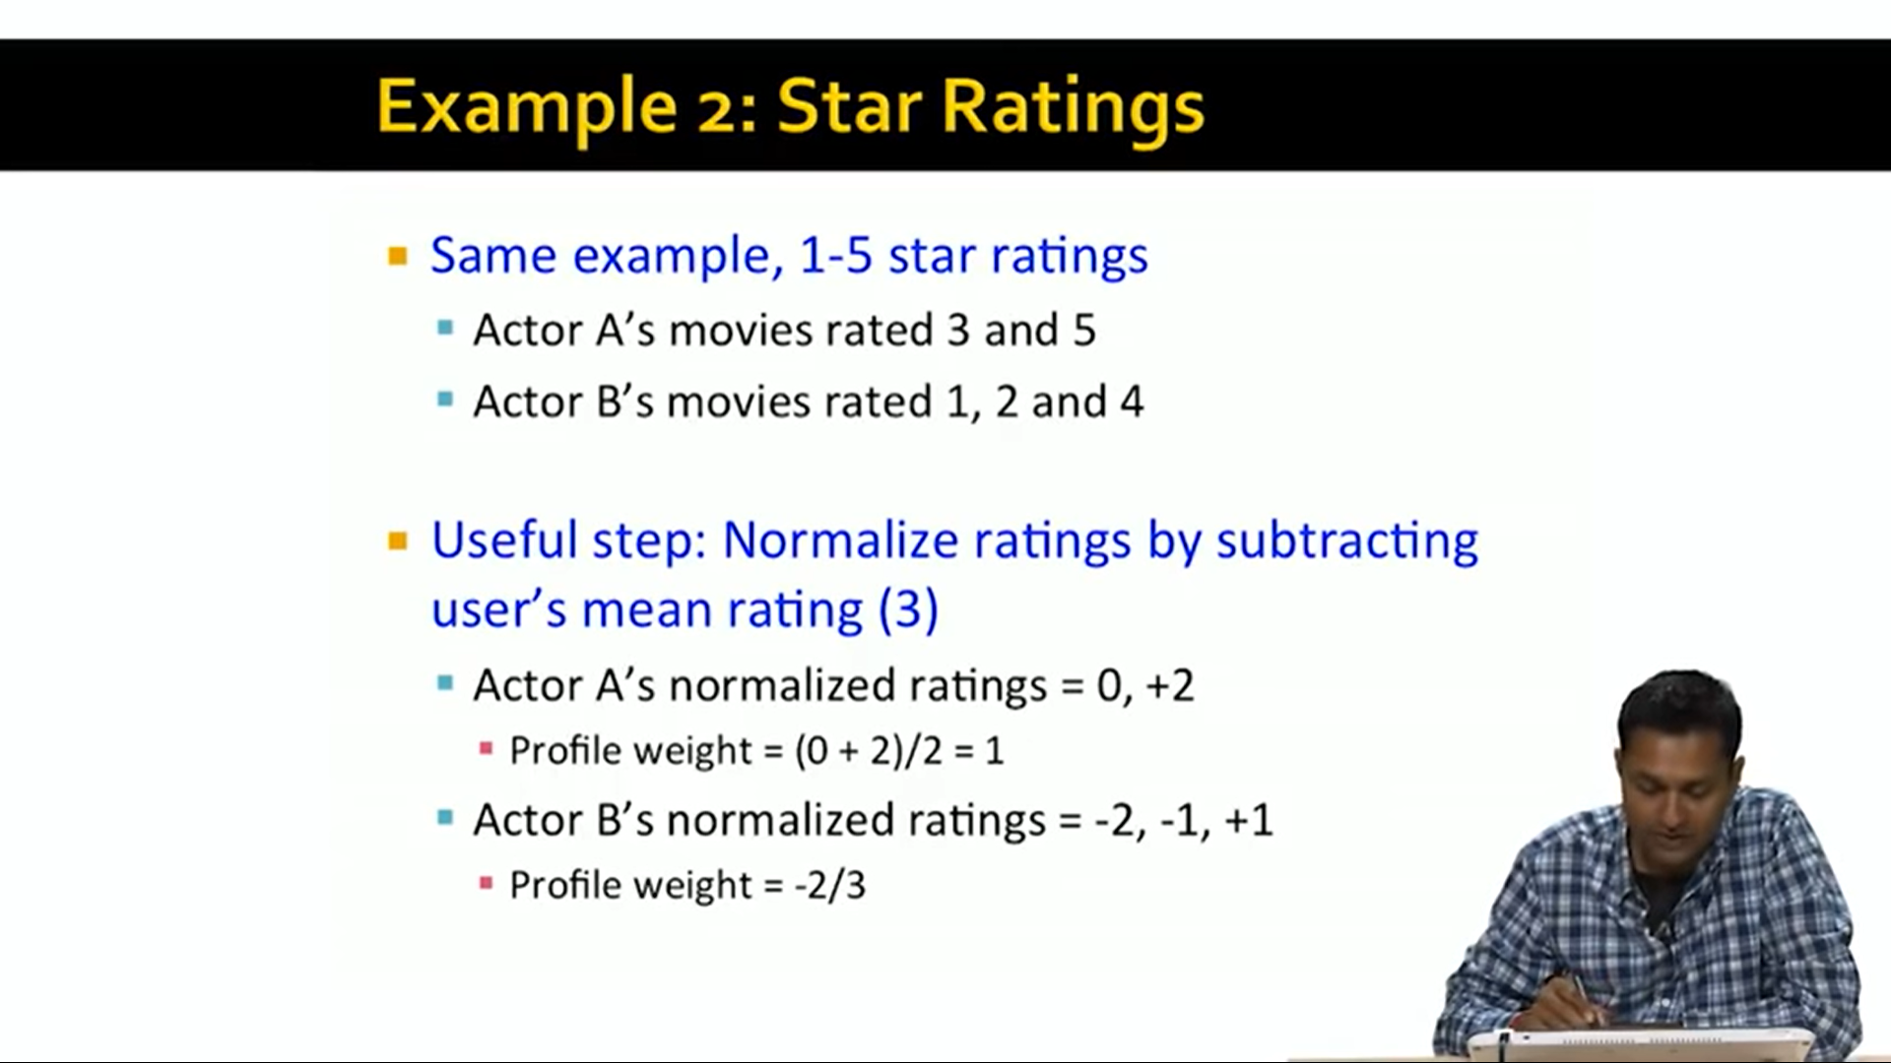
User profile
User has rated items with profiles i1,i2…in
Simple:weighed average of rated item profiles
Variant: Normalize weights using average rating of user

Slide 7
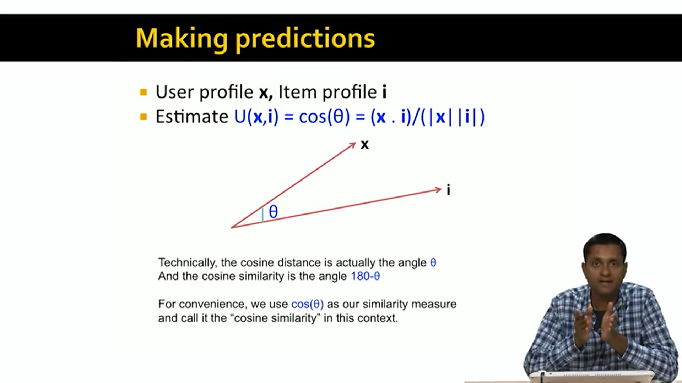
Making predictions
User profile x,Item profile I
Estimate U(x,i) = cos(0) =(x.i)/(|x||i|)

Slide 8
Pros of content-based filtering
No need for data on other users
Able to recommend to users with unique tastes
Explanations for recommended items
a)content features that caused an item to be recommended
Able to recommend new & unpopular items
a) no first rater problem

Slide 9
Cons: content-based approach
Cons
Finding the appropriate featues is hard(ex: images.movies)
Over specialization
a) Never recommends items outside user's content profile
b) people might have multiple interests
c) Unable to exploit quality judgements
Cold start problem for new users
a) how to buld a user profile

Slide 10
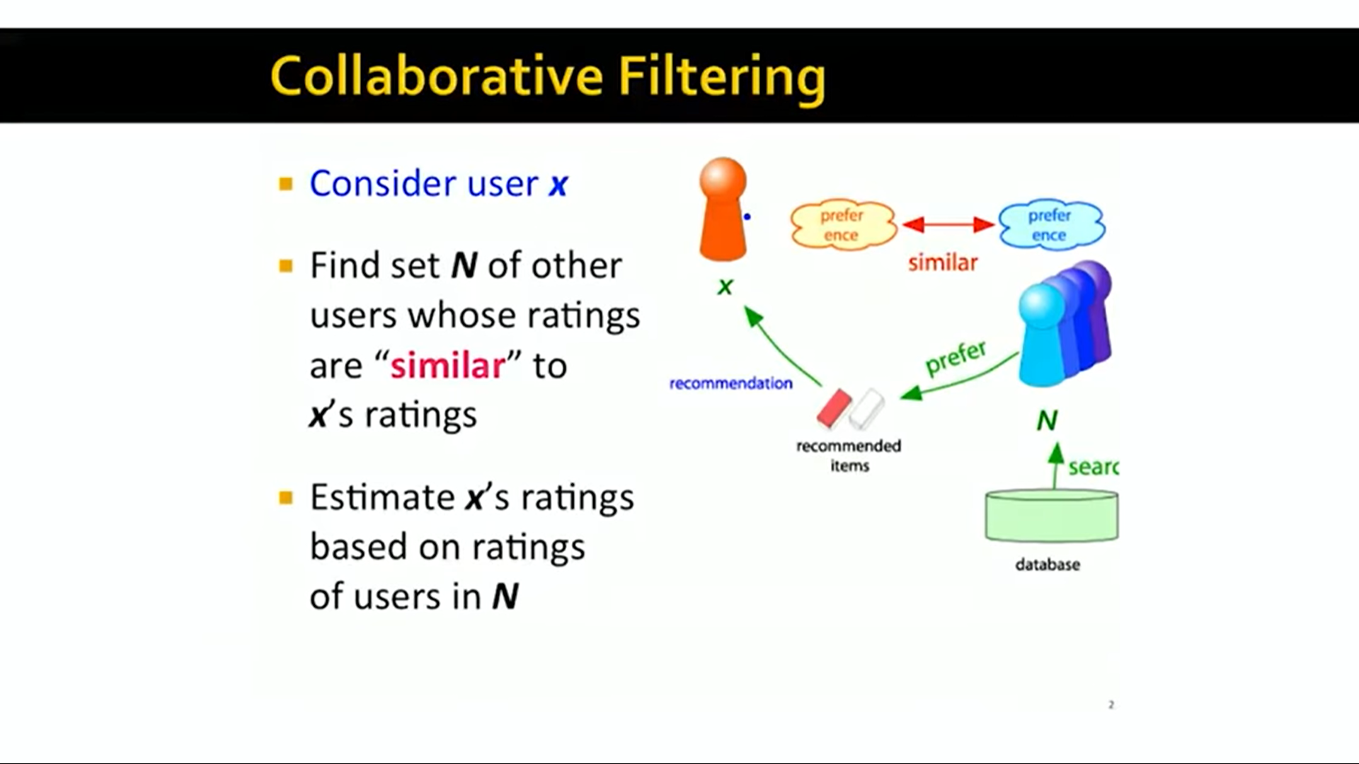
Collaborative filtering
Consider user x
Find set N of other users whose ratings are “Silmilar” to X’s ratings
Estimate x’s ratings based on ratings of users in N

Slide 11
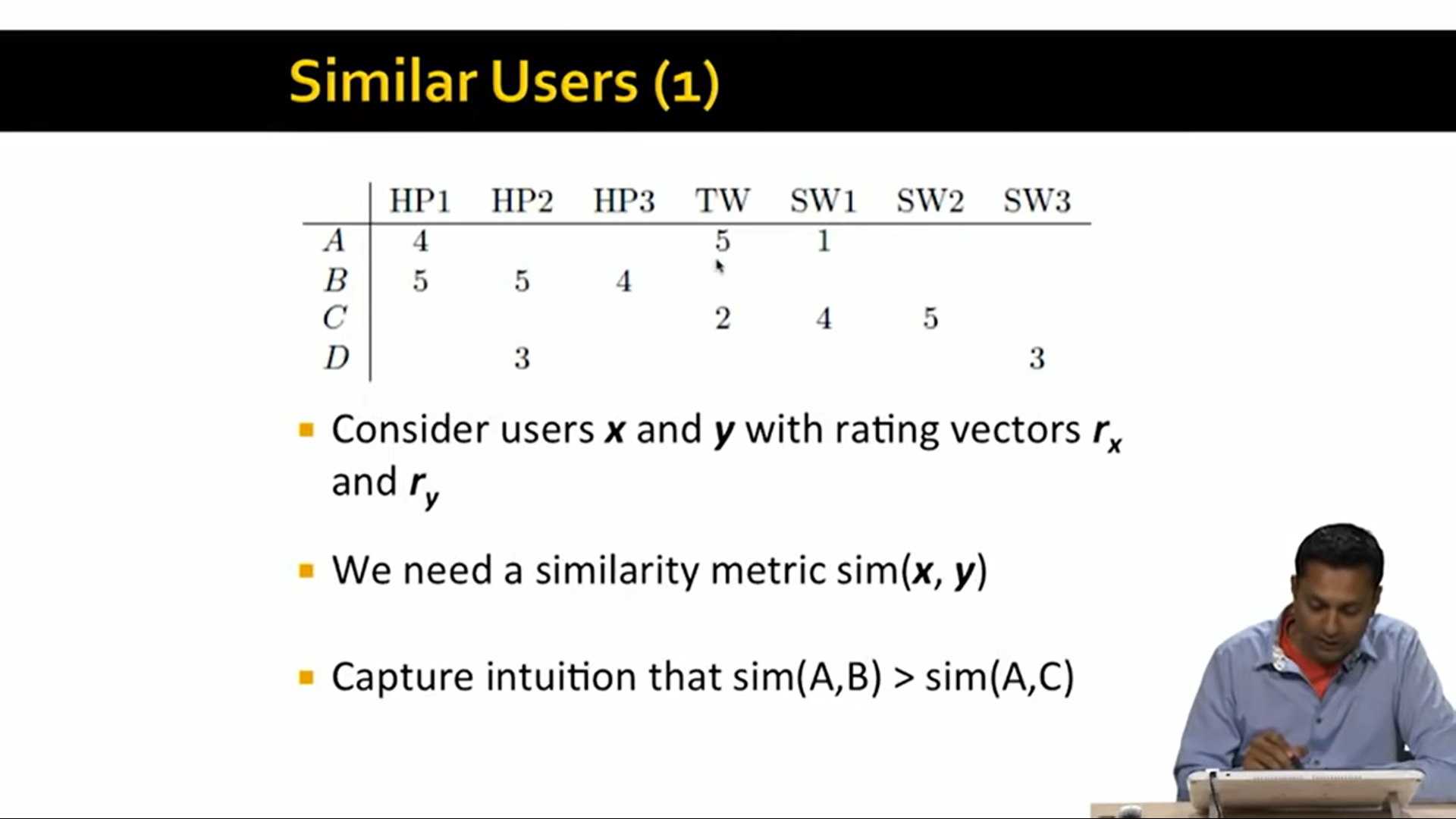
Similarity calculation

Slide 12
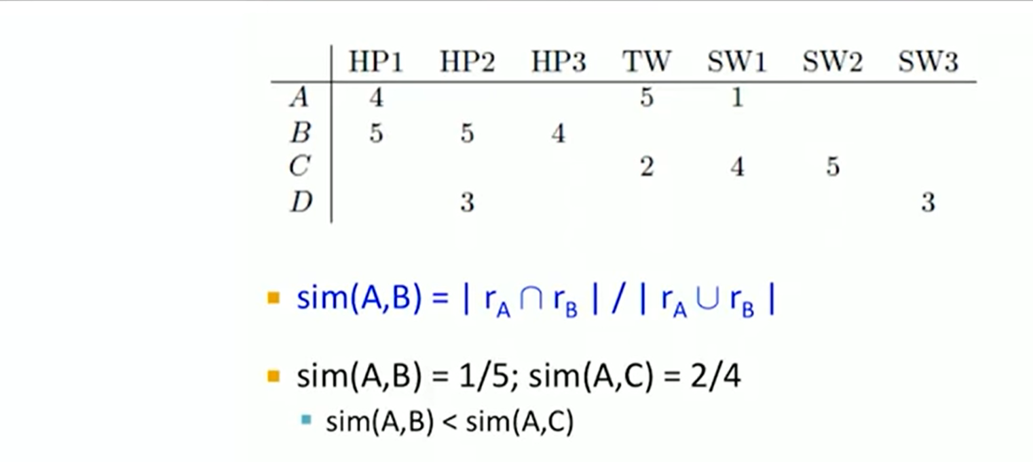
Option 1: Jacard similarity
Igrones rating and missing values

Slide 13
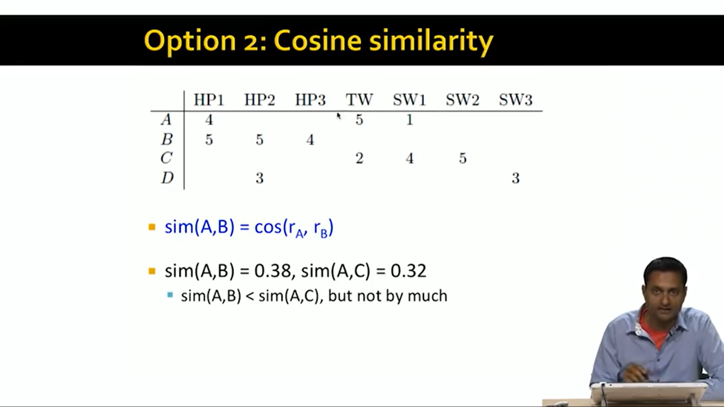
Option 2:Cosine similarity
Treats missing values as negative

Slide 14
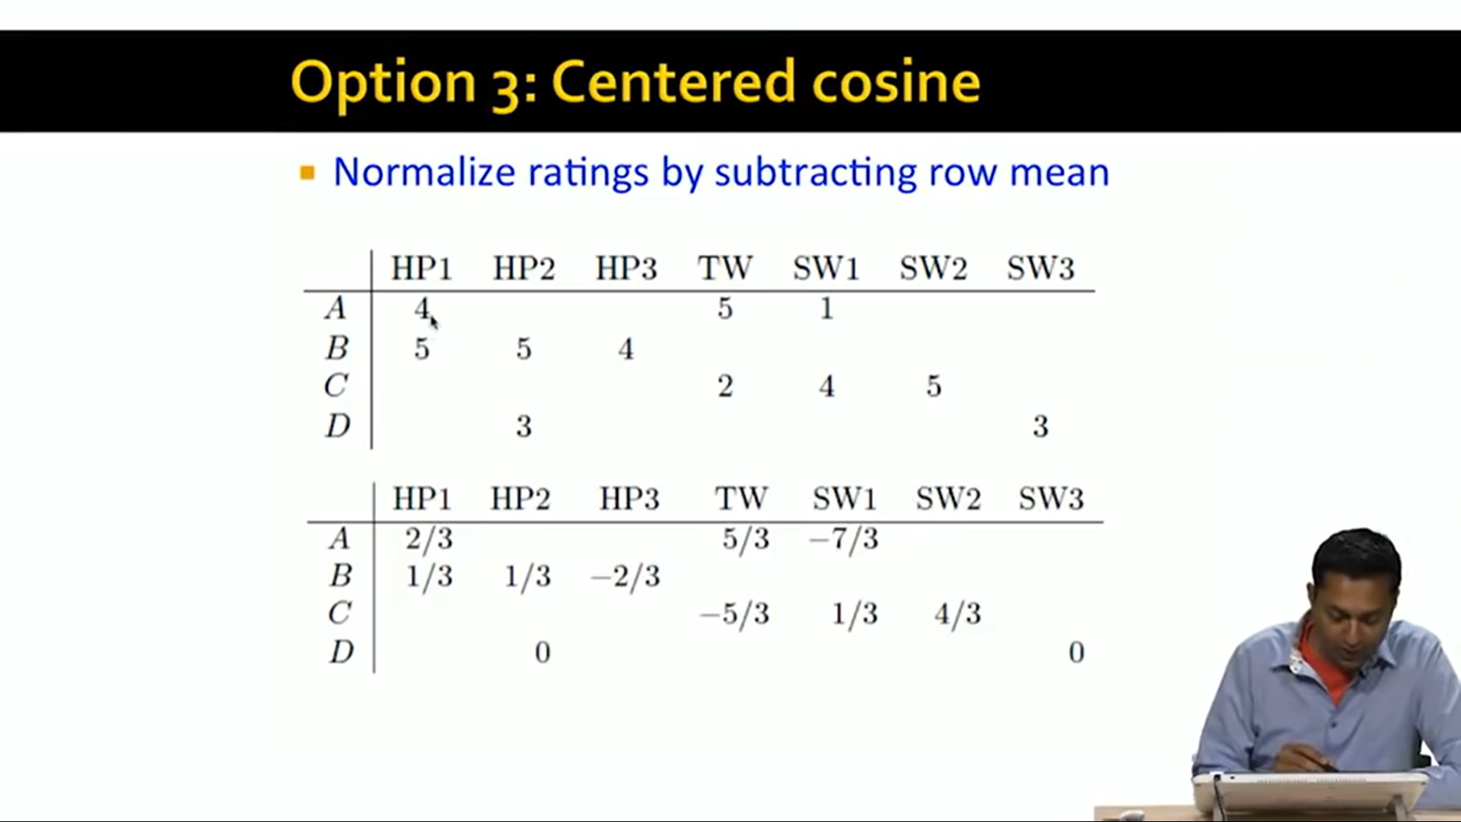
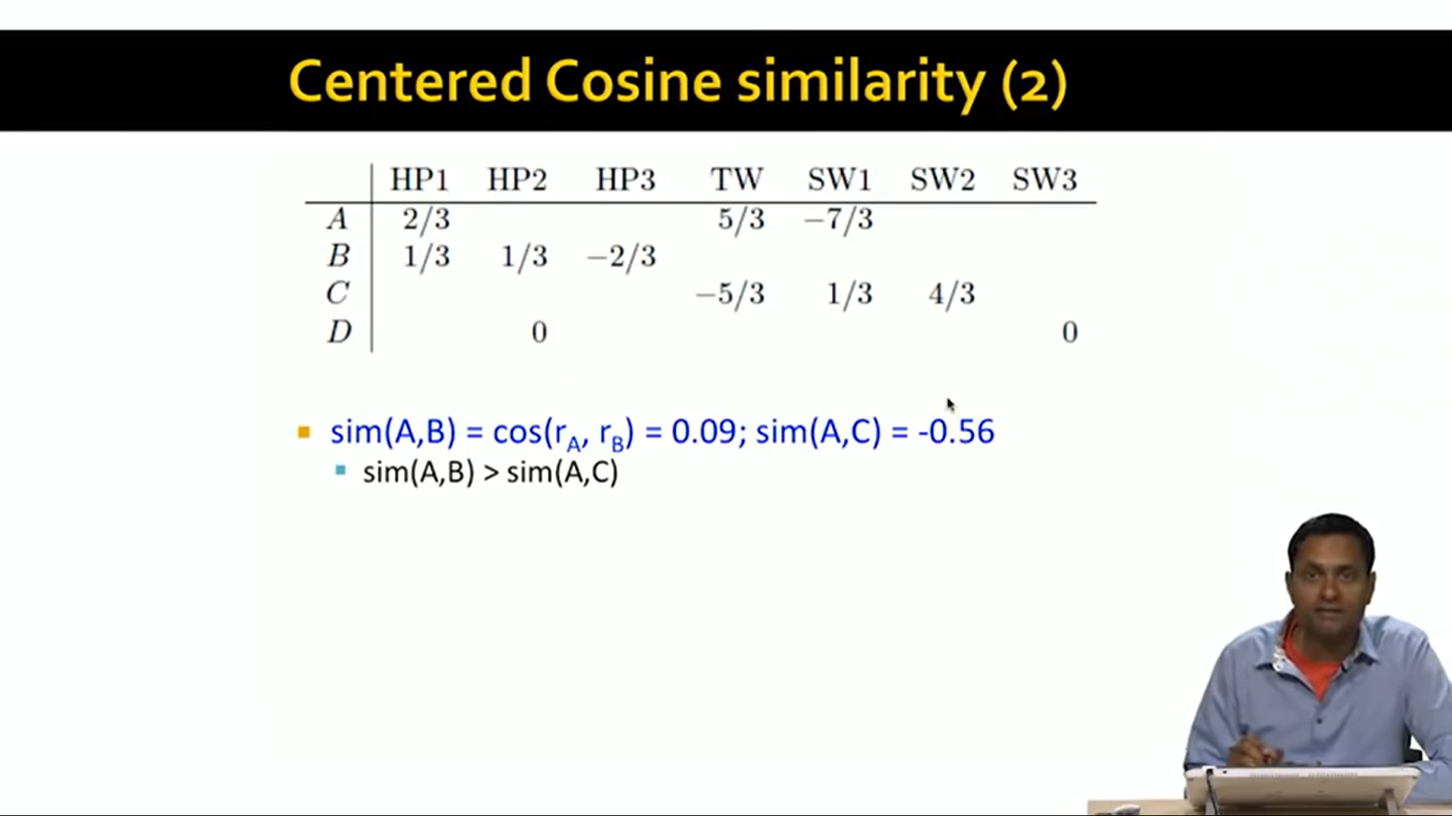
Option 3: centered cosine similarity
Also called as Pearson correlation
Captures intuition better
a) Missising values treated as “average”
b) Handles “tough raters” and “easy raters”

Slide 15
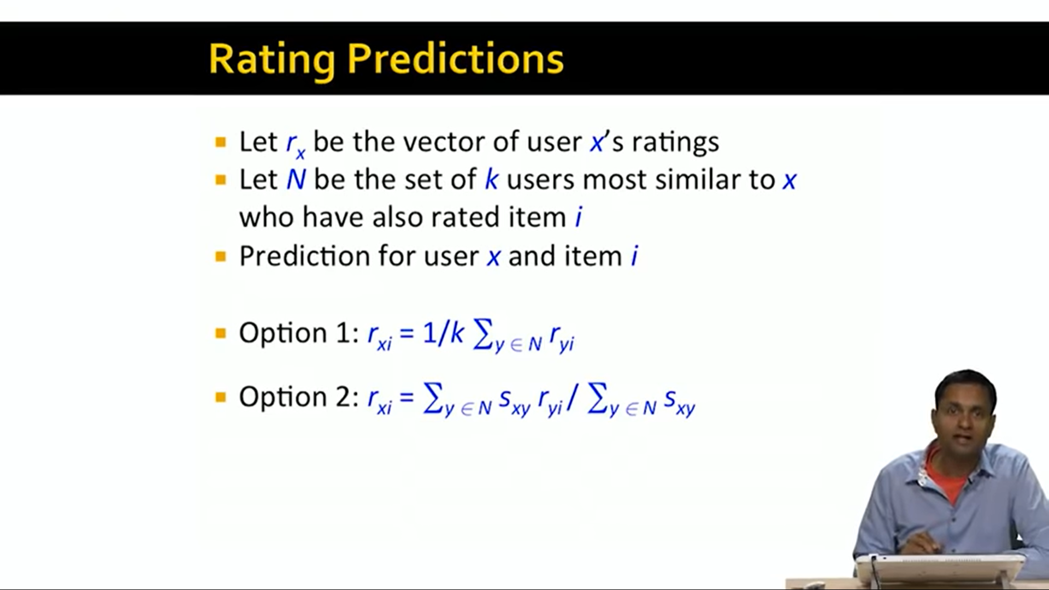
Rating Predictions
Let rx be the vector of users x’s rqatings
Let N be the set of k users most similar to x who jave also rated item i.
Prediction for user x and item I
Can use two options

Slide 16
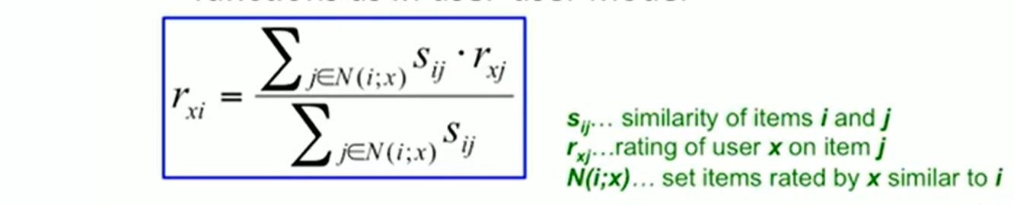
Item-Item collaborative filtering
So far, we used User-User collaborative filtering
Another View: Item-item
a)For item i,find the other similar items
b)Estimate rating for item i based on ratings for similar items
c) can use the same similarity metrics and predction functions in user-user model

Slide 17
Item-Item vs User-User
In practice item-item out preforms user-user in many cases
Items are simpler than users
1) Items belong to a small set of “genres”, users have varied tastes
2)Item similarity is more meaningful than User similarity

Slide 18
Pros and cons of Collaborative filtering
Advantages:
No domain knowledge necessary
The model can help users discover new interests.
the system needs only the feedback matrix to train a matrix factorization model.
Disadvantages:
Cannot handle fresh items
Hard to include side features for query/item

Slide 19
Thank you
Questions??

